Slide 1


Libra/cp2k workflow application:
Modelling excited states in (TiO₂)₄
Miguel Recio
Excited States and Nonadiabatic Dynamics CyberTraining Workshop 2023
Universitat de Barcelona / University at Buffalo

Slide 2
OUTLINE
Motivation: TiO₂ NPs
Libra/cp2k workflow
- Getting initial trajectory*
- TDDFT excitations*
- Computation of NACs and excitation energies
- Run NAMD –> properties of interest
Conclusions
Libra/cp2k workflow application: Modelling excited states in (TiO₂)₄

Slide 3
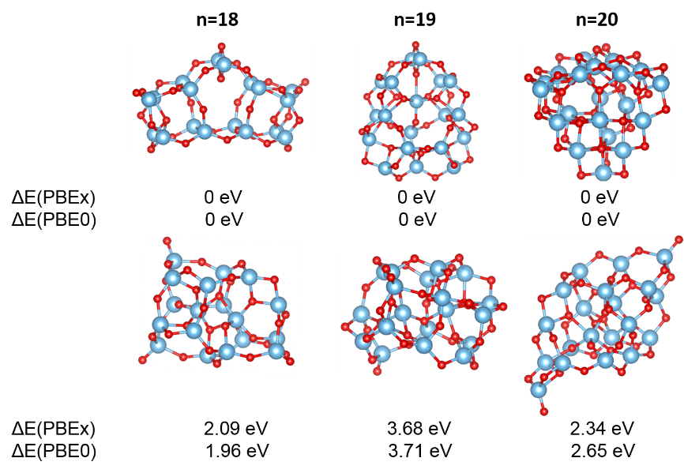
Titania (TiO₂) overview:
-Titania: wide-bandgap semiconductor
-5 decades since seminal discovery (~35000 citations) that anatase crystal TiO₂ is able to split water upon photoexcitation
-Limitations: short lifetime of such photogenerated species. Need of properly understanding charge carrier
recombination dynamics.
Light (< 390 nm)
CB
e⁻
2H⁺
H₂
Reduction
E_{g}
h⁺
H₂O
O₂
via hydroxyl radical
VB
Oxidation
Libra/cp2k workflow application: Modelling excited states in (TiO₂)₄

Slide 4
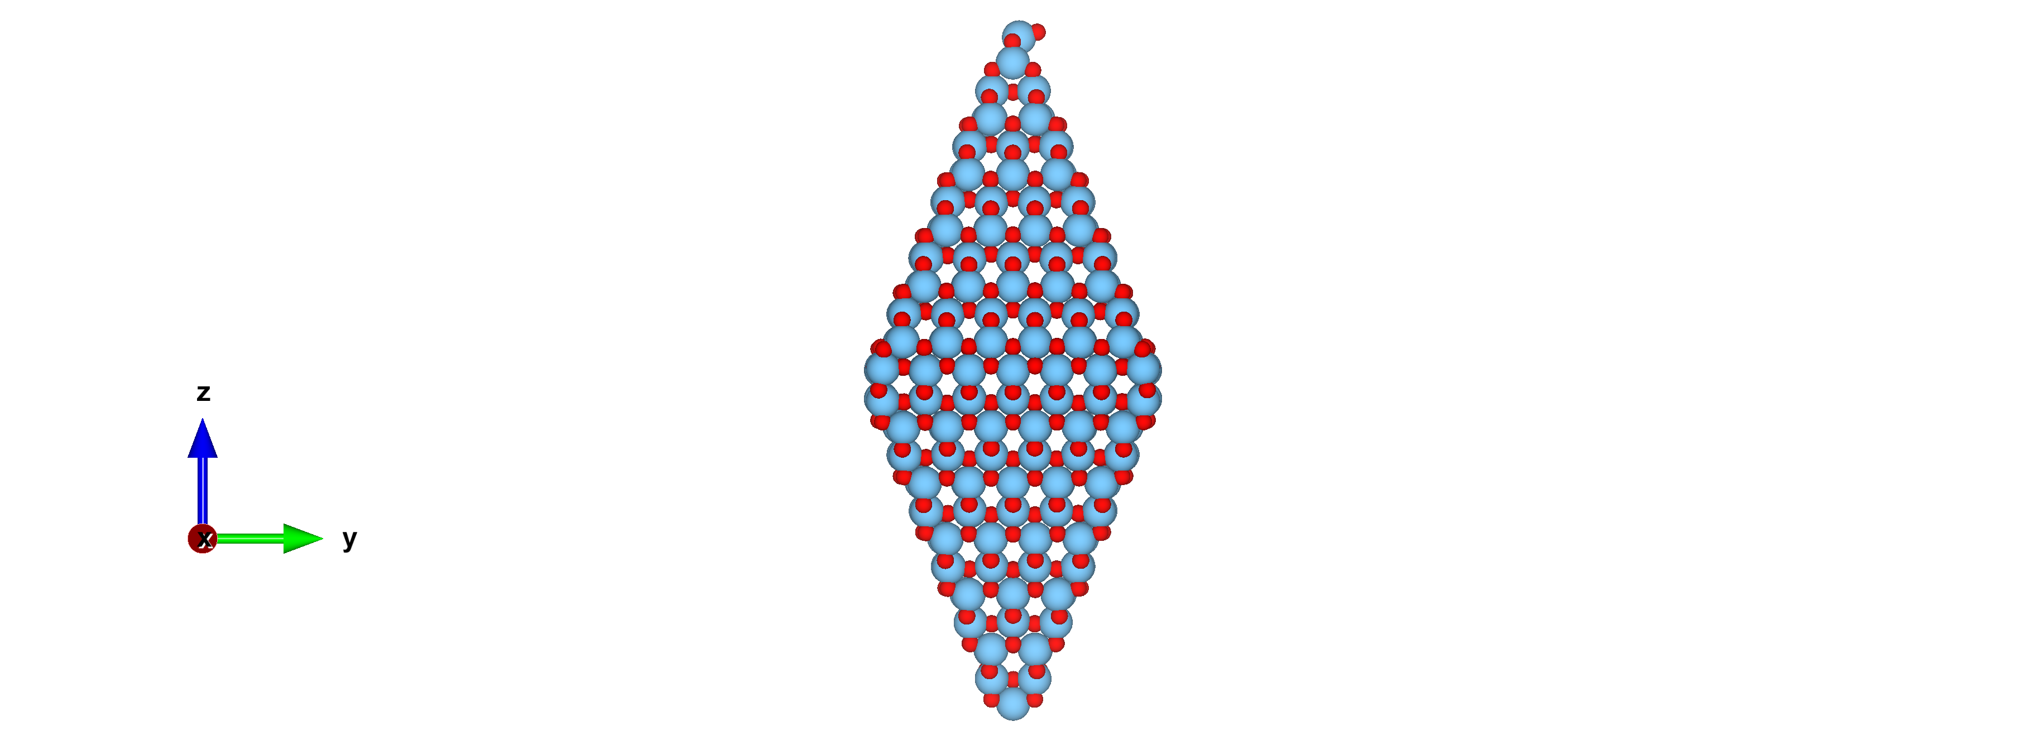
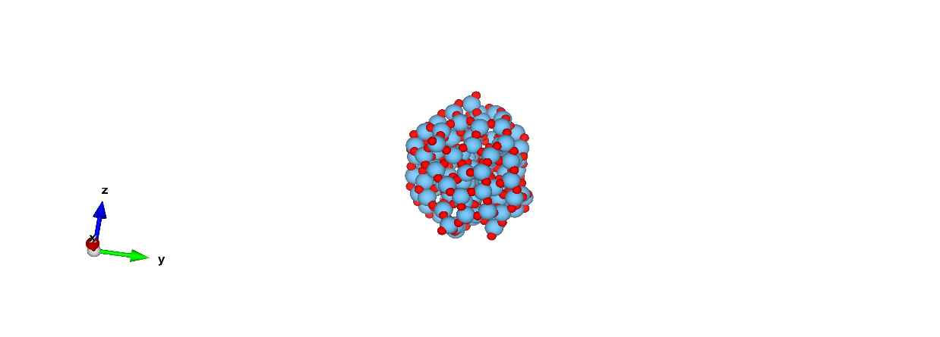
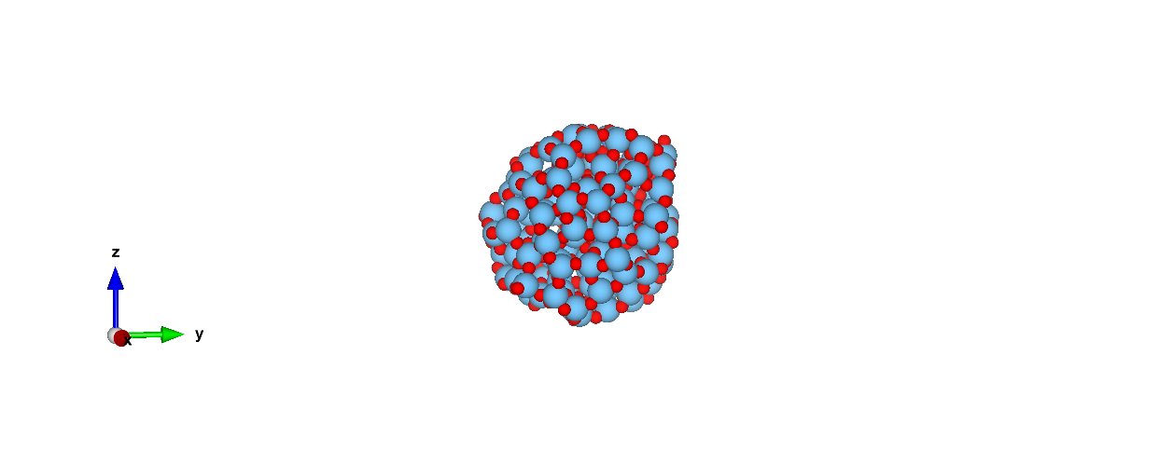
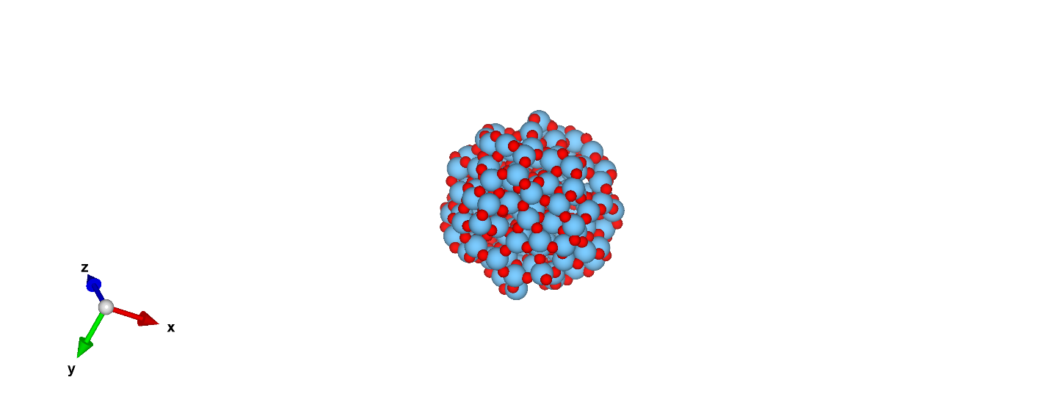
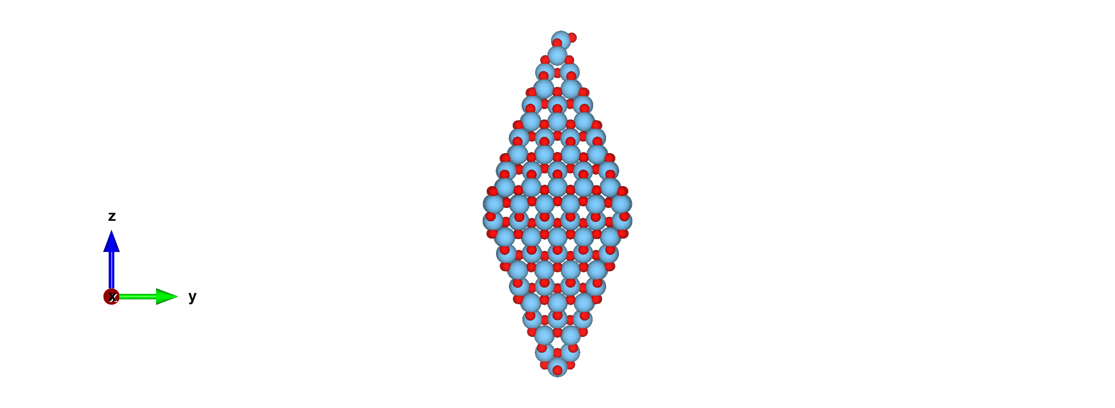
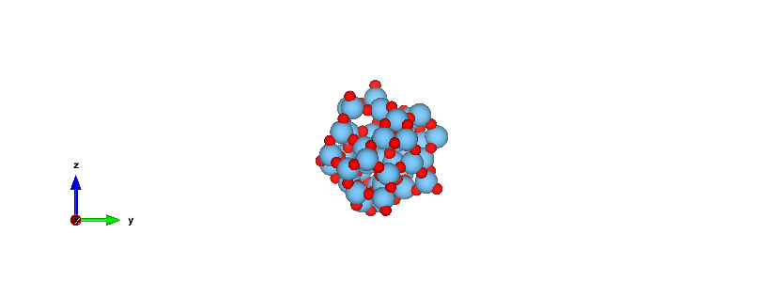
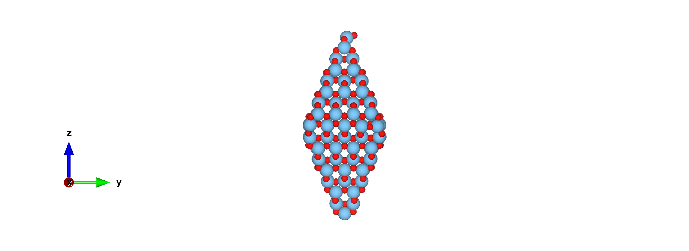
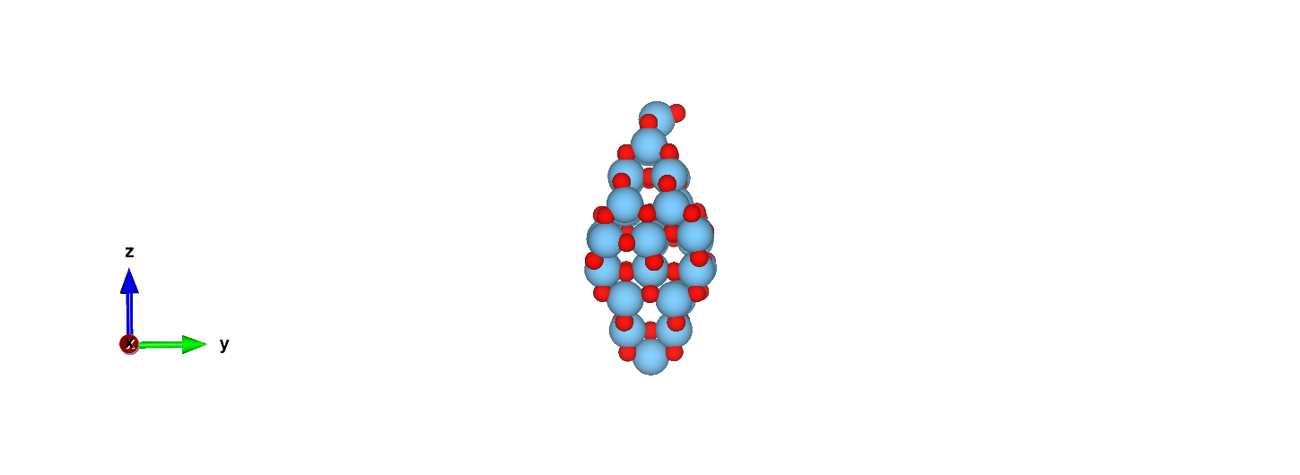
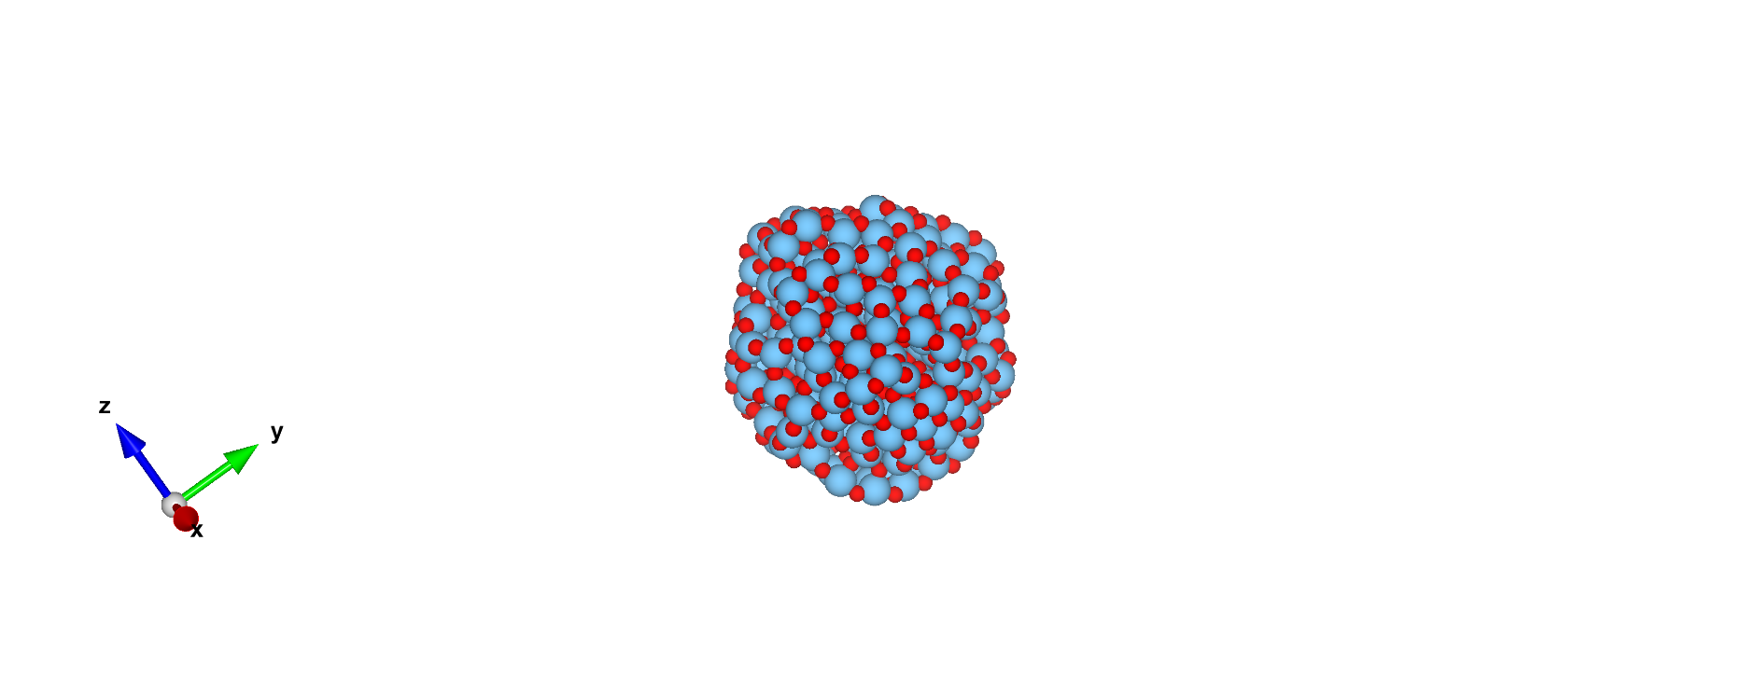
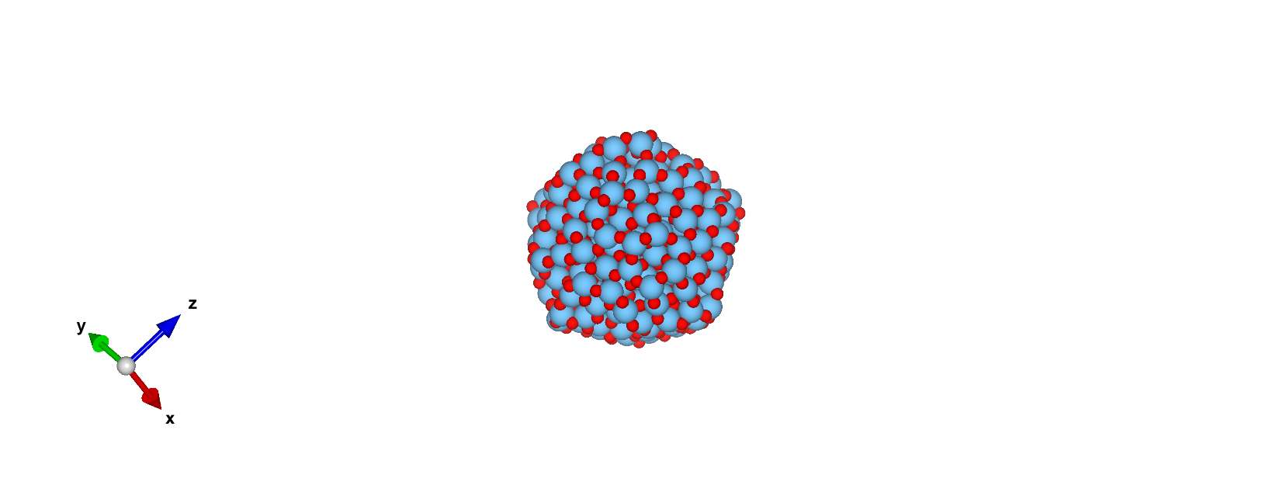
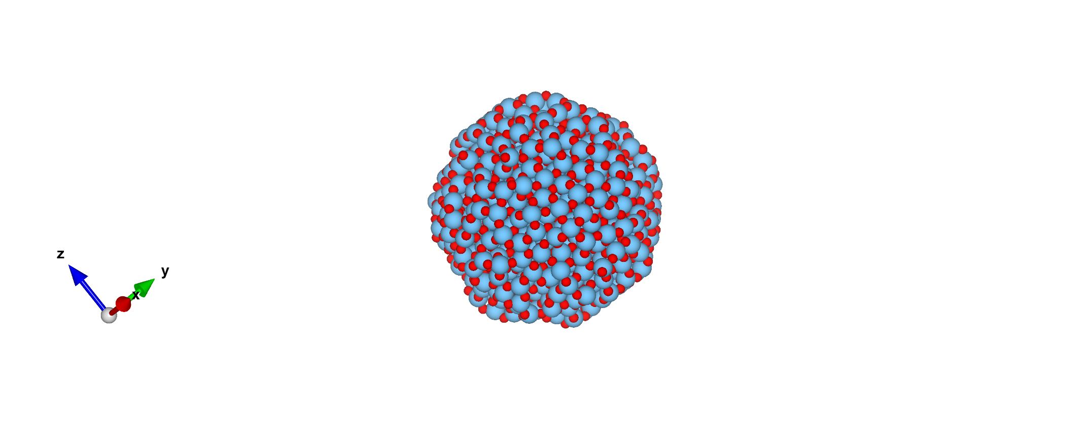
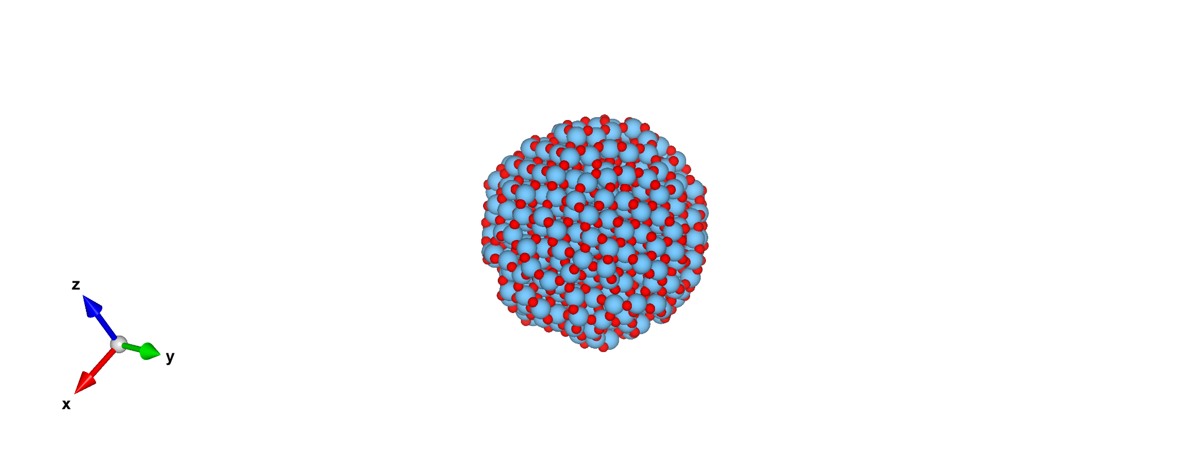
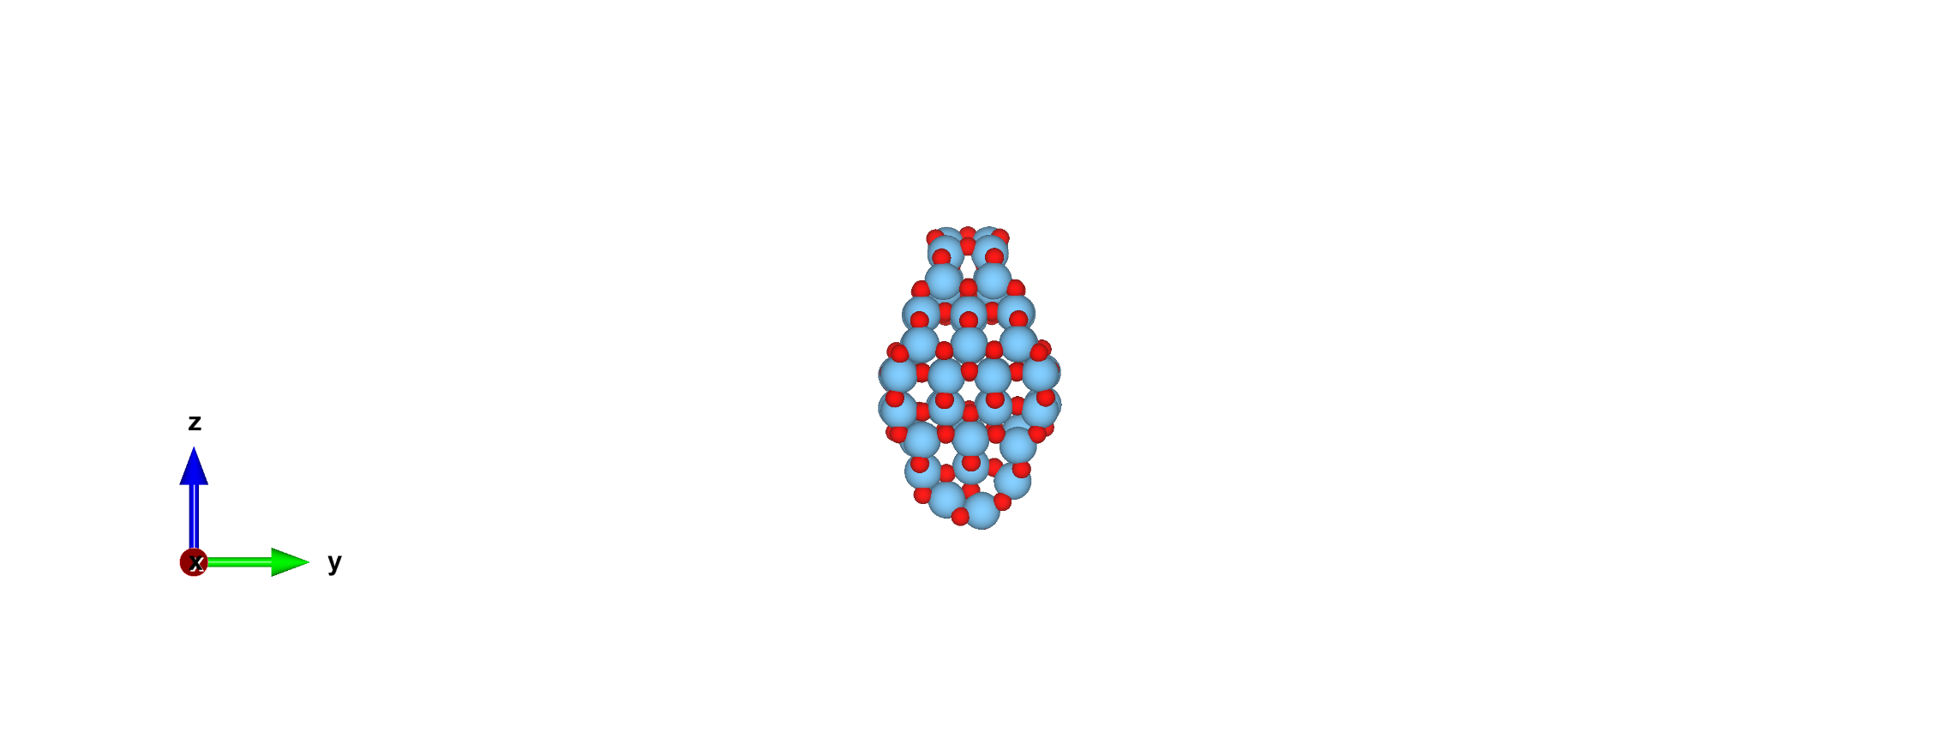
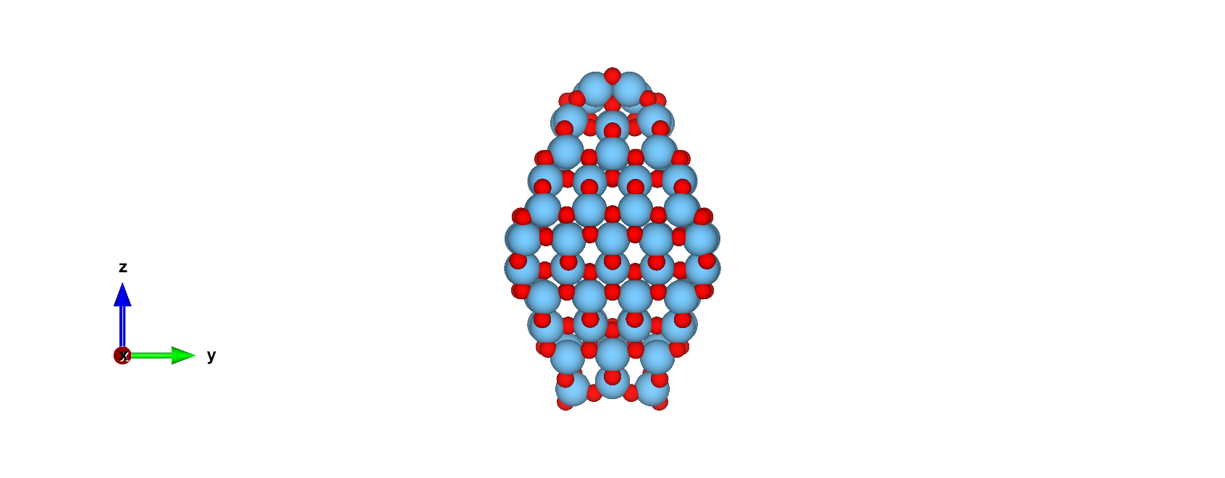
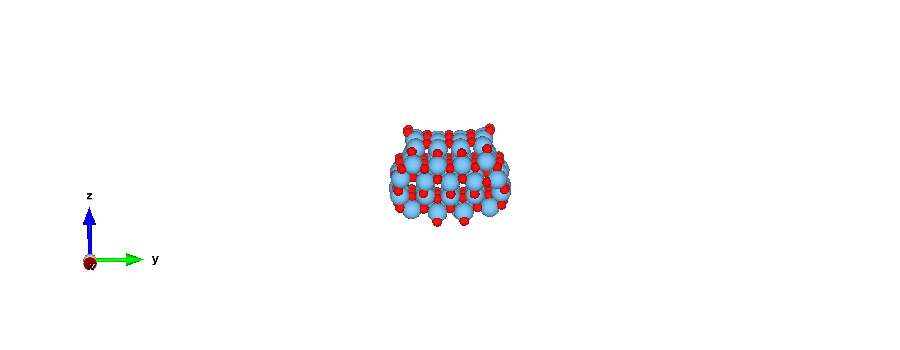
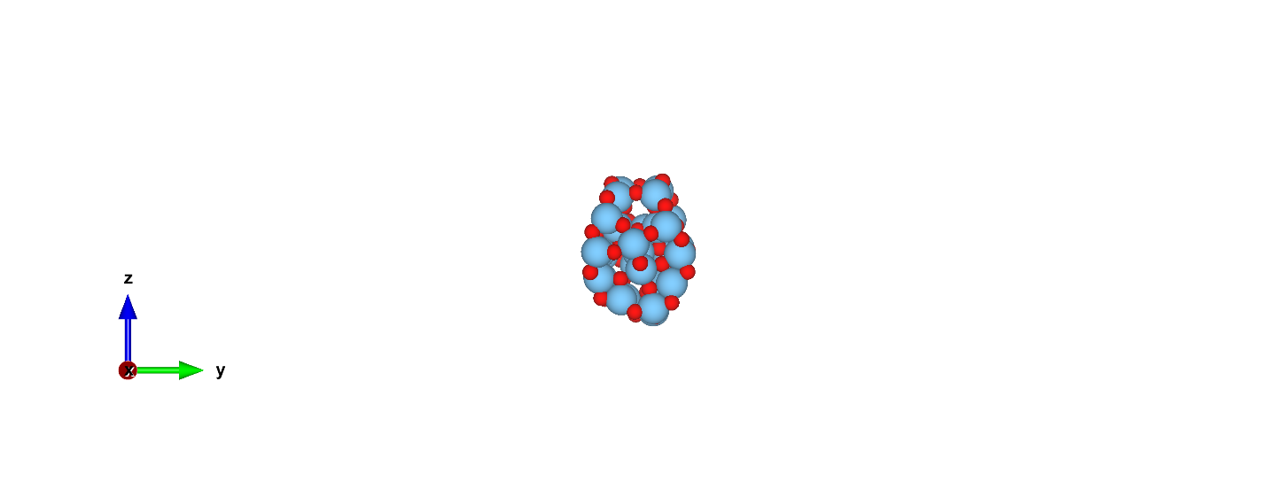
{101} facets
(TiO₂)₄₃
(TiO₂)₁₁₅
(TiO₂)₁₃₆
(TiO₂)₁₆₂
(TiO₂)₂₅₇
(TiO₂)₃₅
(TiO₂)₈₄
(TiO₂)₁₆₅
(TiO₂)₄₅₅
{101}/{001} facets
(TiO₂)₂₃₇
(TiO₂)₂₉
(TiO₂)₇₈
(TiO₂)₉₇
(TiO₂)₁₅₁
(TiO₂)₅₁₁
(TiO₂)₅₈₅
Libra/cp2k workflow application: Modelling excited states in (TiO₂)₄

Slide 5
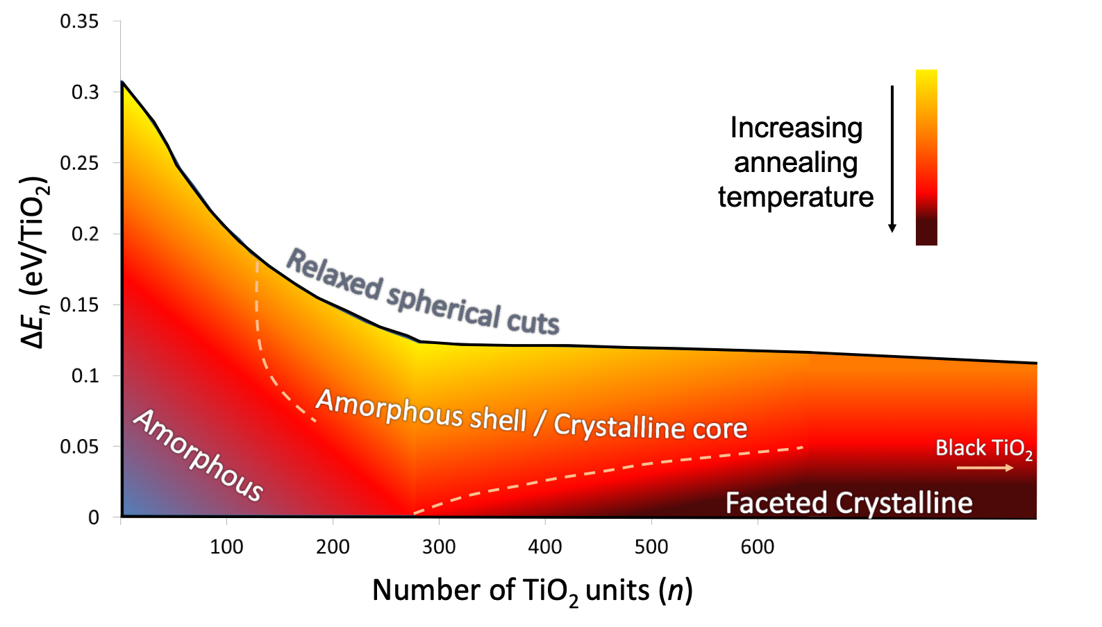
We have analyzed GS properties (energetics, structural, band gaps)…
What about the excited states???
Libra/cp2k workflow application: Modelling excited states in (TiO₂)₄

Slide 6
cp2k/Libra workflow overview:
classical MD (force field)
Singe Particle
Many-body
Singe Particle
Many-body
Singe Particle
Many-body
DFT-MD
xTB
Singe Particle
Many-body
Excitations with TDDFT
TSH method
Excitations with TDDFT
Compute the nonadiabatic couplings, excitation energies,…
Compute the nonadiabatic couplings, excitation energies,…
Computing the molecular orbital overlaps and time-overlaps
Compute the nonadiabatic couplings, excitation energies,…
Running molecular dynamics
Computing the molecular orbital overlaps and time-overlaps
Running nonadiabatic molecular dynamics
NACs
Excit. energies
trajectory movie
time-overlaps, CI
States populations
State recovery times
Libra/cp2k workflow application: Modelling excited states in (TiO₂)₄

Slide 7
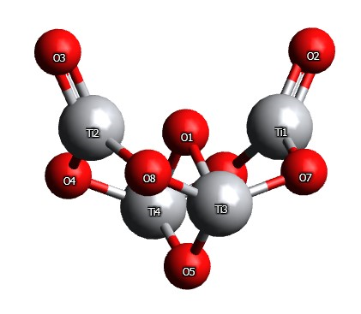
cp2k/Libra workflows: step 1
classical MD (force field)
Test-system: globally optimized (TiO₂)_{4NP}
MD-DFT
Excitations with TDDFT
Computing the molecular orbital overlaps and time-overlaps
Running molecular dynamics
(MD) Simulations -> 1 ps trajectory at 300 K
GULP: Classical MD (NanoTiO IP)
CP2K: ab-initio MD (PBE)
trajectory movie
Libra/cp2k workflow application: Modelling excited states in (TiO₂)₄

Slide 8
cp2k/Libra workflows: step 2
classical MD (force field)
MD-DFT
Excitations with TDDFT:
PBE and PBE0
After step 1 and step 2:
4 methodologies:
IP MD + PBE TD-DFT
IP MD + PBE0 TD-DFT
DFT MD + PBE TD-DFT
DFT MD + PBE0 TD-DFT
Computing the molecular orbital overlaps and time-overlaps
Running molecular dynamics
-Analyze the effect of the methodology for preparing our trajectoy file
-PBE vs PBE0 treatment of excitations
trajectory movie
Libra/cp2k workflow application: Modelling excited states in (TiO₂)₄

Slide 9
cp2k/Libra workflows: step 2
Excitations with TDDFT: PBE and PBE0
Single Particle
Many-body
“Gaussian cubefile”-based approach
to compute the MO overlaps and time-overlaps
Excited sates of nanoscale systems are multiconfigurational
Computing the molecular orbital overlaps and time-overlaps
Compute the nonadiabatic couplings, excitation energies,…
Many-body effects play an important role
10 excited states composed by the squares of the configuration interaction (CI) coefficients.
time-overlaps, CI
Libra/cp2k workflow application: Modelling excited states in (TiO₂)₄

Slide 10
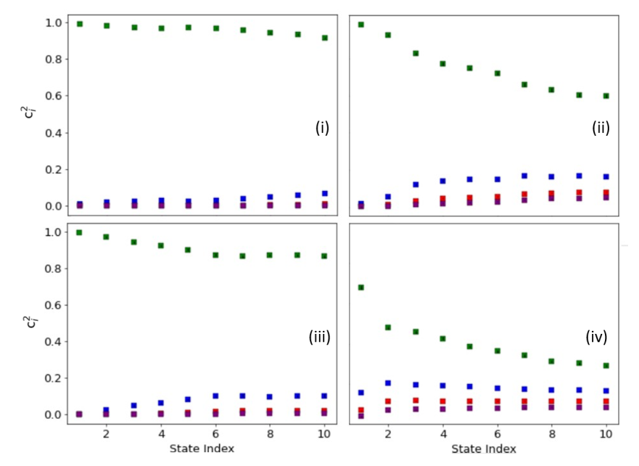
cp2k/Libra workflows: step 2
(i), (iii): single SD excitation dominance that starts to slowly break down.
No big differences between using classical or AIMD
(ii), (iv) Using PBE0 for computing the TDDFT excitations leads to a stronger multiconfigurational description of our excited states.
Libra/cp2k workflow application: Modelling excited states in (TiO₂)₄

Slide 11
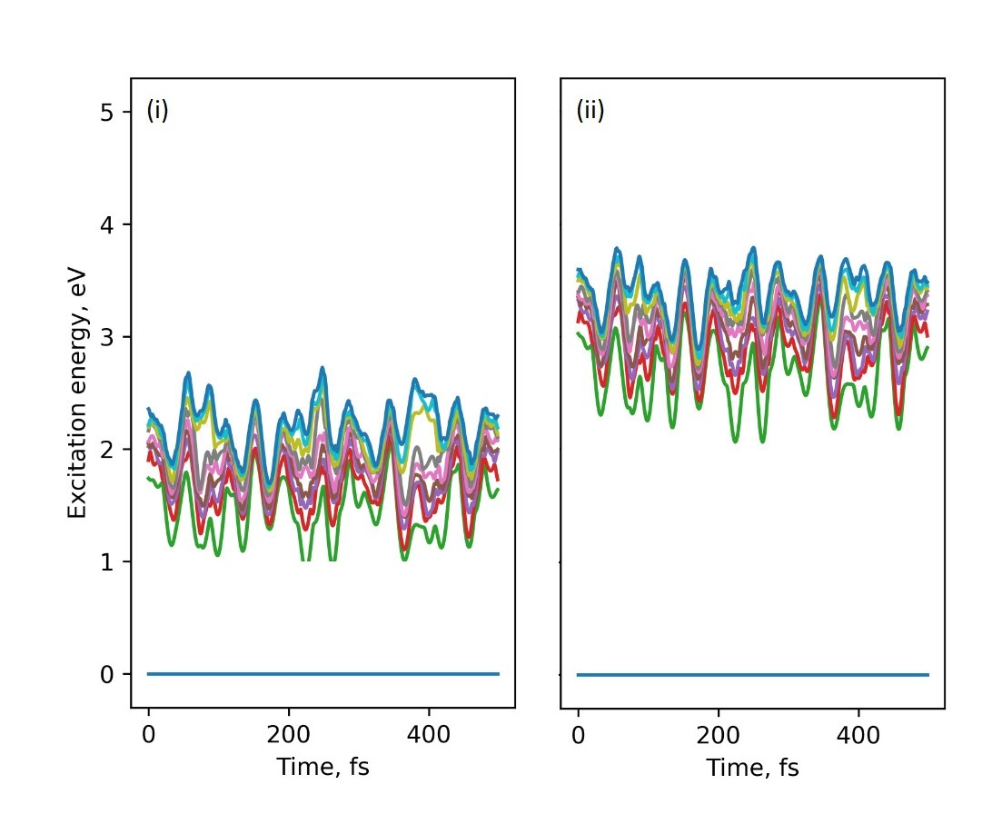
cp2k/Libra workflows: step 3
Many-body
TSH method
Compute the nonadiabatic couplings, excitation energies,…
Running nonadiabatic molecular dynamics
NACs
Excit energies
Libra/cp2k workflow application: Modelling excited states in (TiO₂)₄
Libra/cp2k workflow application: Modelling excited states in (TiO₂)₄

Slide 12
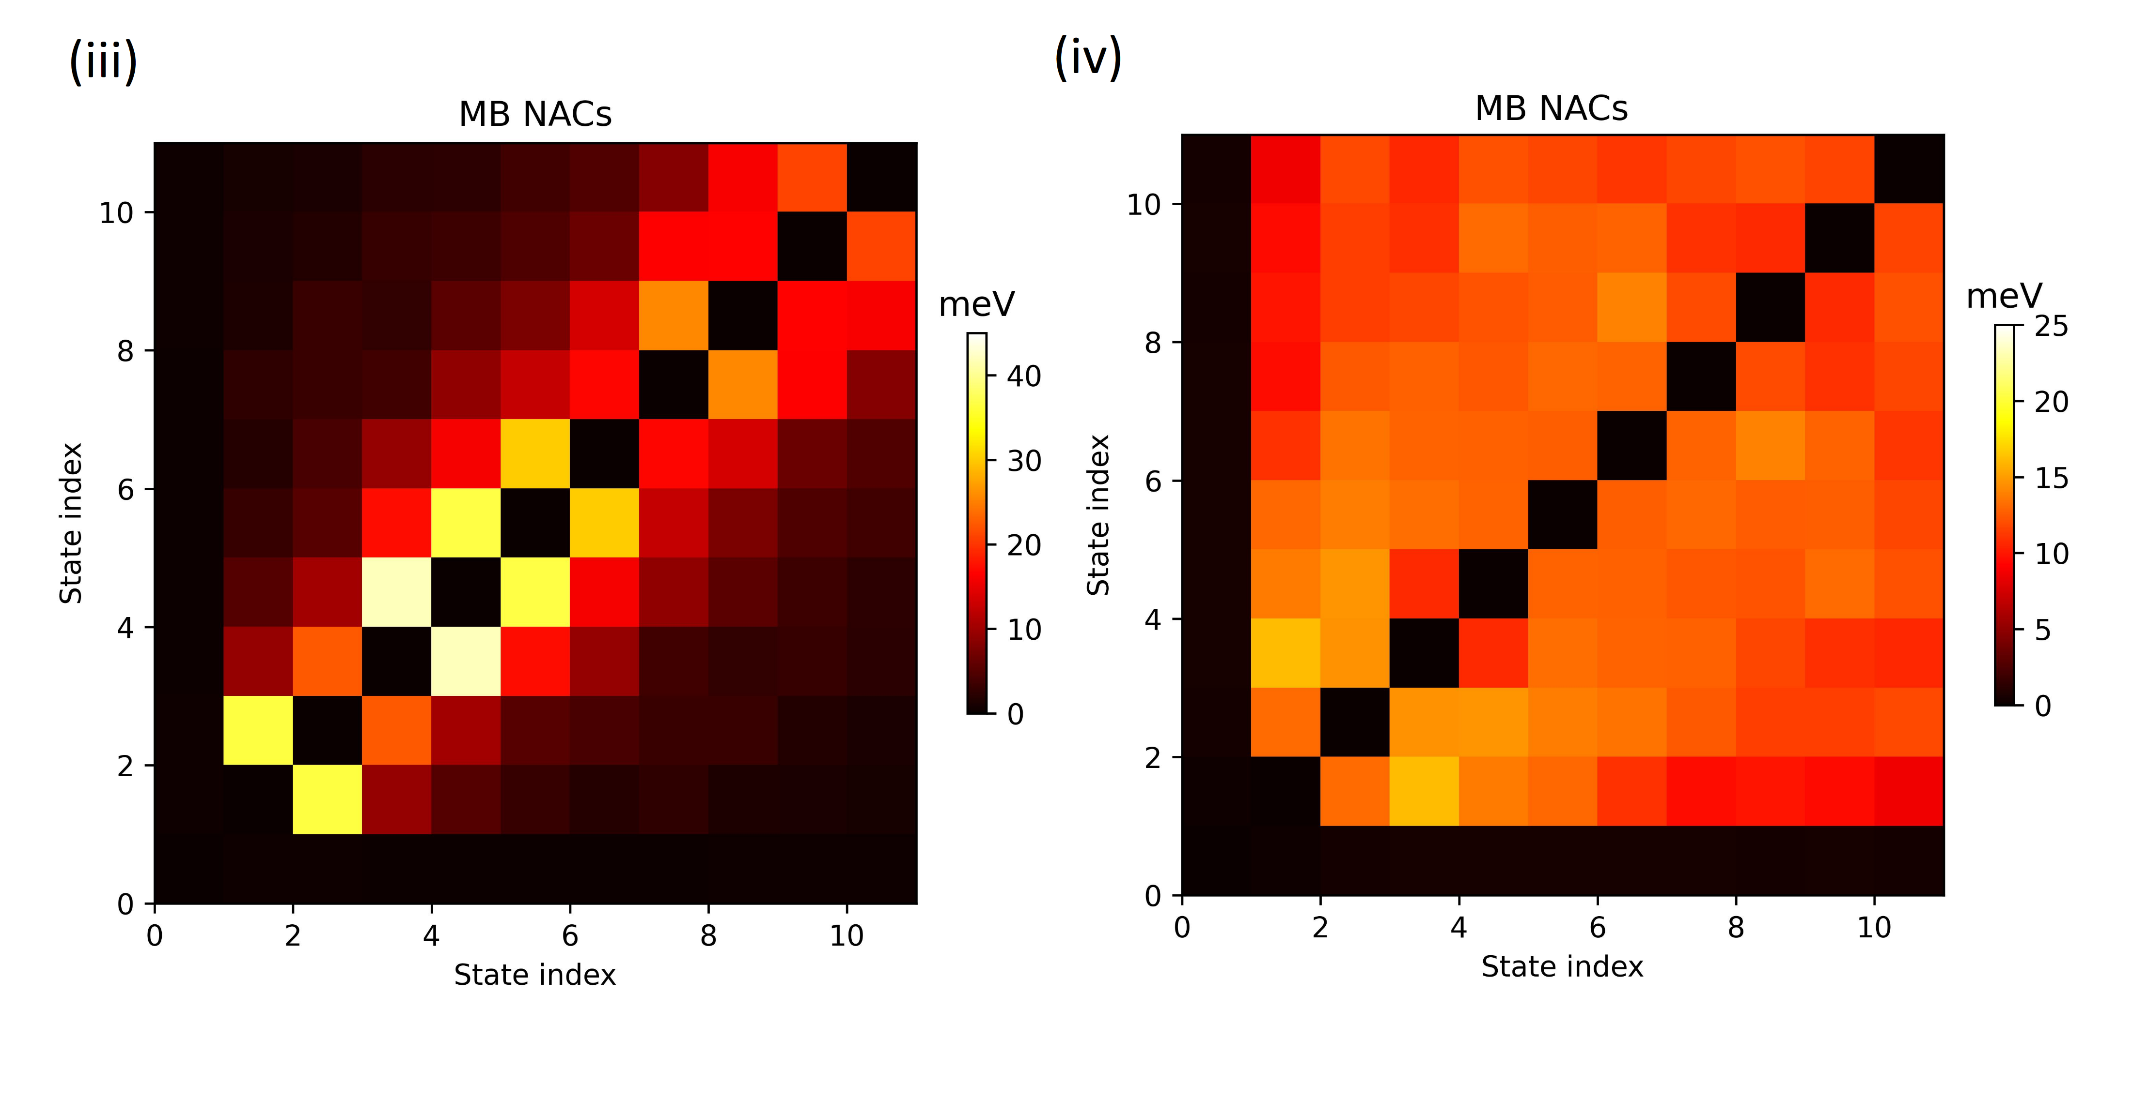
cp2k/Libra workflows: step 3
Many-body
TSH method
Compute the nonadiabatic couplings, excitation energies,…
Running nonadiabatic molecular dynamics
NACs
Excit energies
Libra/cp2k workflow application: Modelling excited states in (TiO₂)₄

Slide 13
cp2k/Libra workflows: step 4
Singe Particle
Many-body
we pick ten geometries of our MD runs (step 1)
as starting points
we use 40 different sets of initial conditions for our FSSH trajectories
Run 400 nonadiabatic dynamics of 1000 fs
FSSH
Compute the nonadiabatic couplings, excitation energies,…
Running nonadiabatic molecular dynamics
NACs
Excit energies
calculating magnitudes of interest
(population recovery times)
States populations
State recovery times
Libra/cp2k workflow application: Modelling excited states in (TiO₂)₄

Slide 14
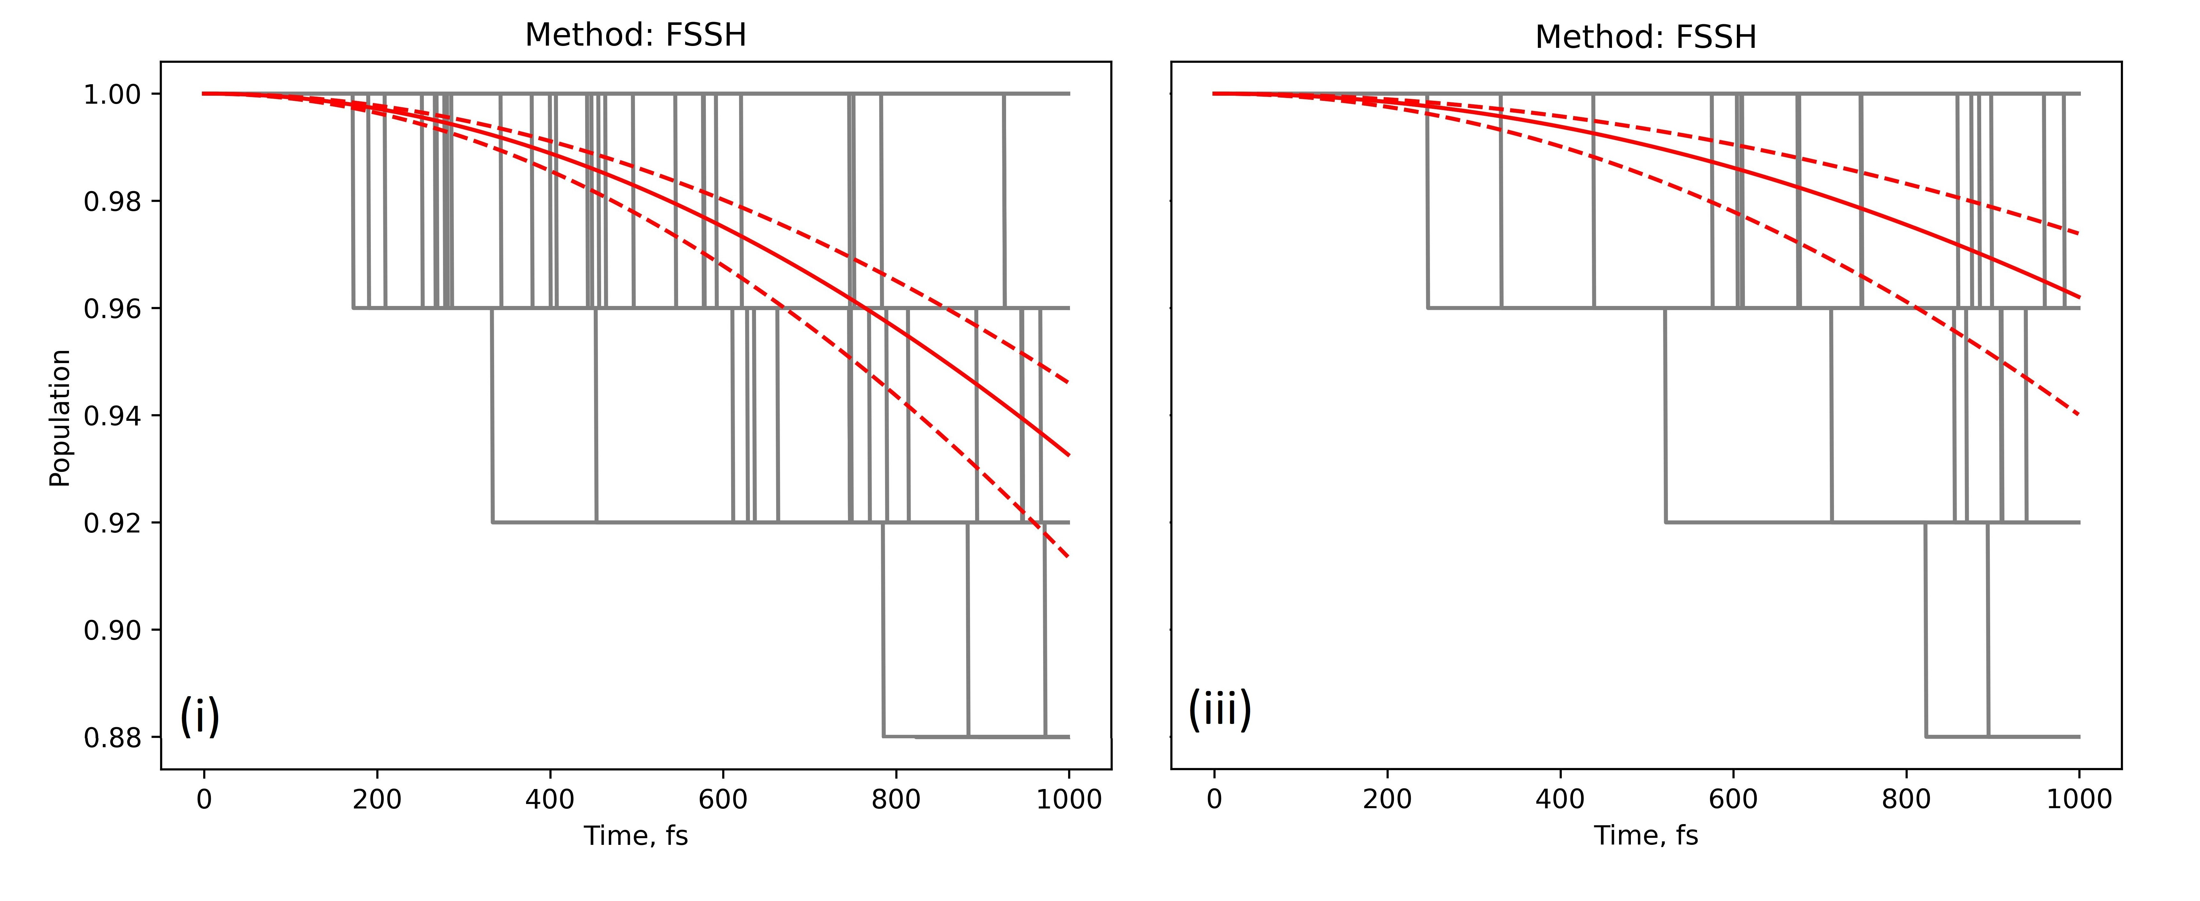
cp2k/Libra workflows: step 4
Exponential fit for the average population recovery time (red solid line) among all trajectories Longer recovery time in AIMD preparation case.
The faster decay of ground state in figure (i) will point towards the use of classical MD in step 1.
Libra/cp2k workflow application: Modelling excited states in (TiO₂)₄

Slide 15
CONCLUSIONS
- Implementation of Libra/CP2K workflow to a small TiO₂ NP
We obtained quantities of interest (recovery times).
Further analysis and connection to charge recombination times is needed.
Use of classical and ab-initio MD for getting initial trajectory
PBE vs PBE0 treatment of excitations
Use larger simulation times, introduce decoherence,… REKS?
Libra/cp2k workflow application: Modelling excited states in (TiO₂)₄

Slide 16
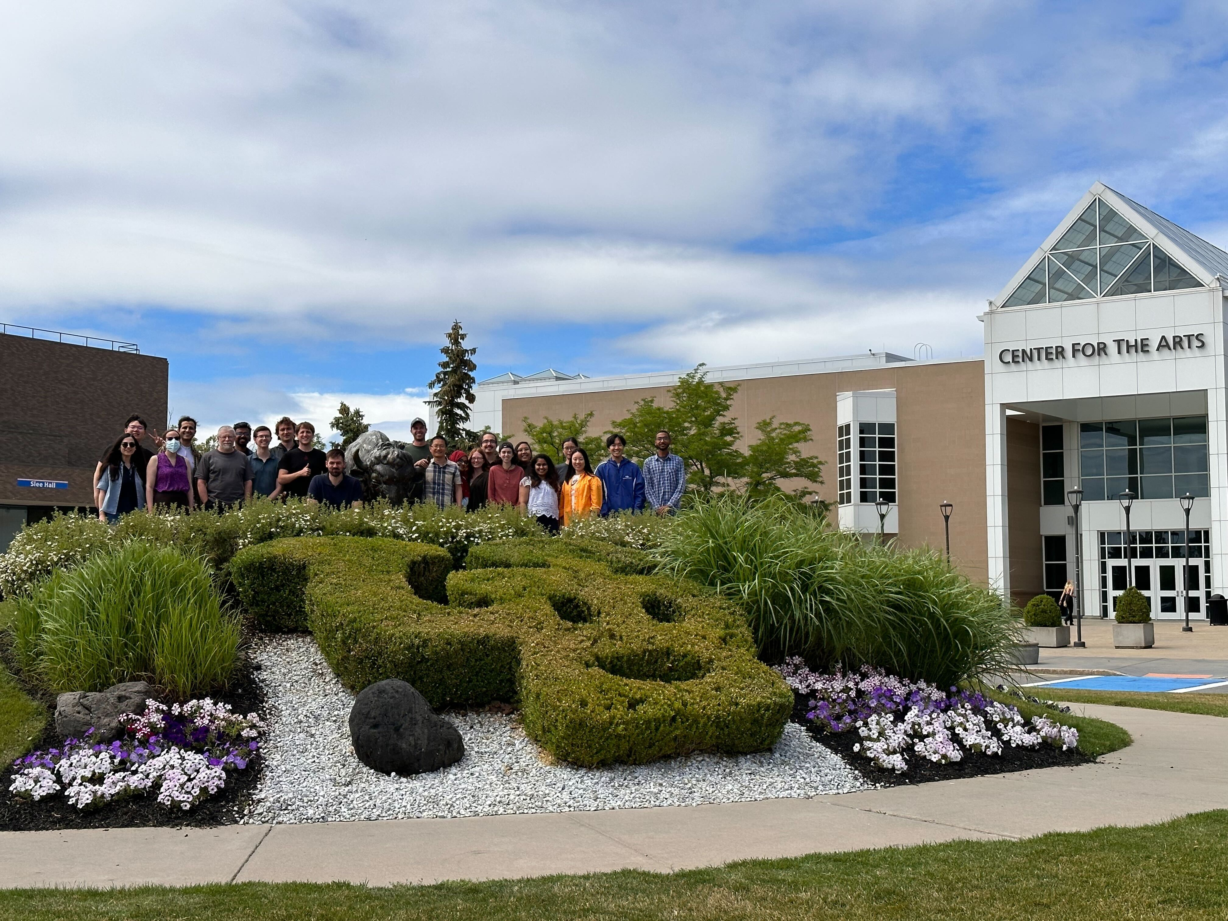
THAT’S ALL
THANKS!!
Libra/cp2k workflow application: Modelling excited states in (TiO₂)₄

